Slide 1



ATILQ GRANDS
Hospitality
Analysis
CodeBasics Resume Project Challenge #2
More Project Details.

Slide 2

Introduction

Slide 3

Contents
Understanding the AtliQ Hospitality Business | 4
Problem Statement | 5
Dashboard Overview | 6
Data Model | 7
Dashboard Analysis | 9

Slide 4
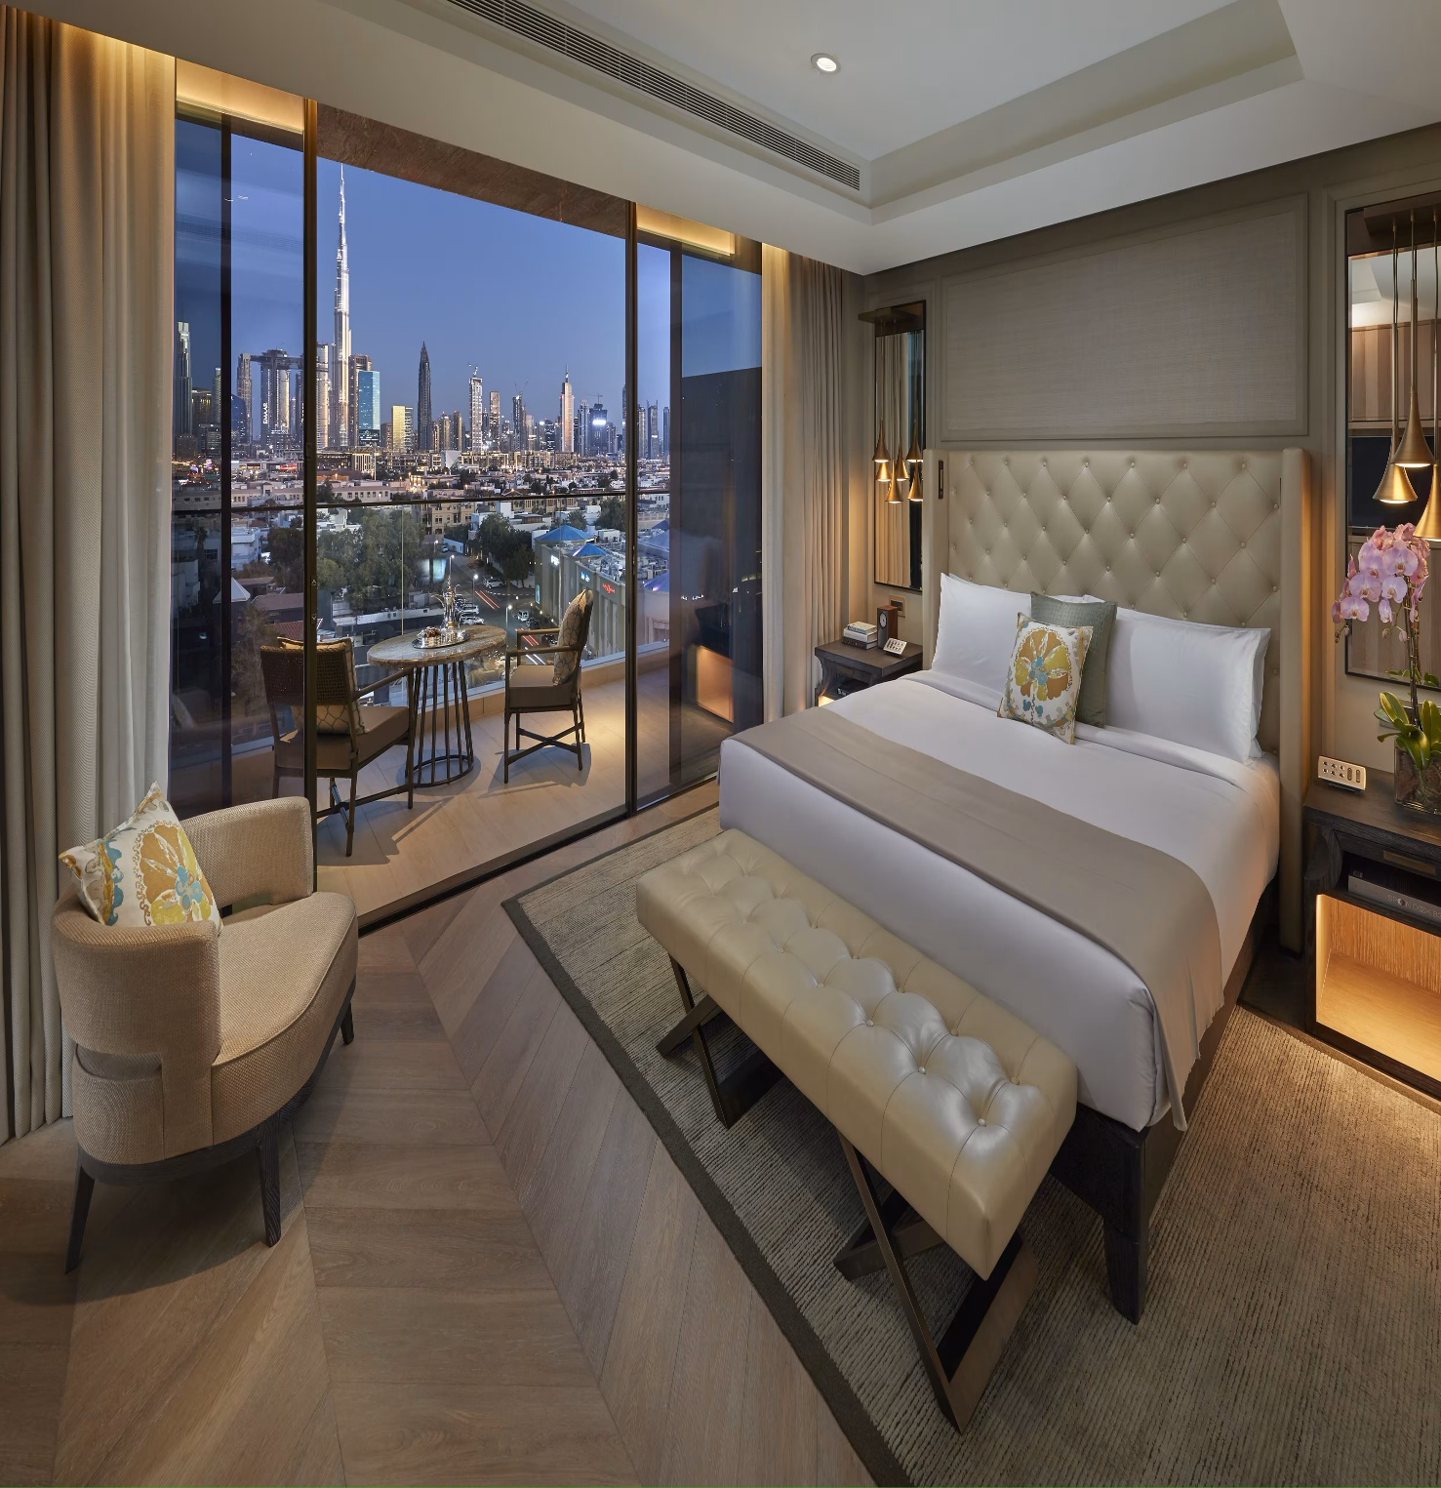
About the Business
Atliq Grands, a leading hospitality group with over two decades of experience, operates a chain of prestigious five-star hotels across India. Their portfolio includes Atliq Bay, Atliq City, Atliq Exotica, Atliq Grands, Atliq Palace, and Atliq Seasons, strategically located in four major metropolitan cities: Bangalore, Mumbai, Hyderabad, and Delhi.

Slide 5

Problem Statement

Slide 6
Performance Overview
Dashboard Overview
Further Analysis
I developed four dashboards using a dataset comprising five tables (three dimension and two fact tables). The data spans from May 1st to July 31st, 2022, These dashboards are
Revenue Insights
Booking Insights

Slide 7
Data Model

Slide 8
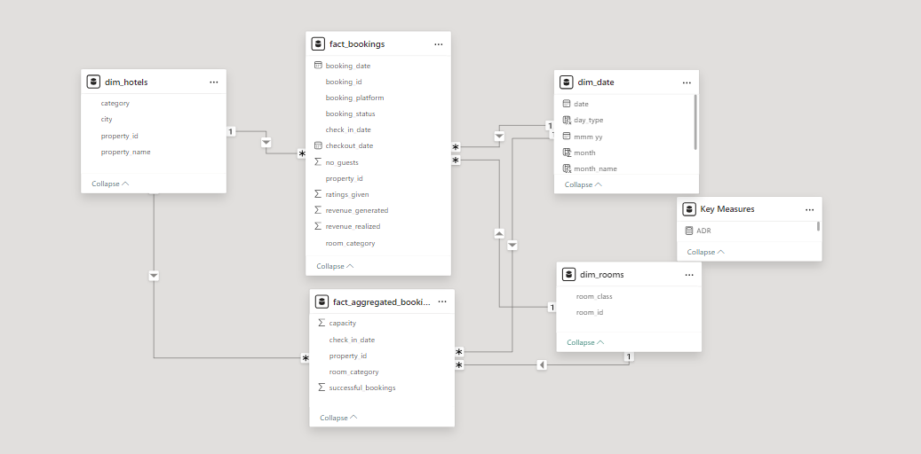
Back to Agenda
Briefly elaborate on what you want to discuss.

Slide 9
Actual Dashboard

Slide 10


Slide 11
Provide Your Feedback
Notes:
I'd love to hear your thoughts on the analysis and any other insights you may have. Please feel free to leave a comment below or connect with me on LinkedIn for further discussion.

Slide 12



Connect with me.
Email
badernader2@gmail.com
LinkedIn
@badernader

